Slide 1
AA Assignment
Chen Han
T02
S10202961

Slide 2
Introduction
Column | Description
text | BBC news stories /Documents
category | The label for each document: business, entertainment, politics, sport, tech
Given a dataset (bbc-text.csv) consists of 2225 documents from the BBC news website corresponding to stories in five topical areas from 2004-2005.
Perform text analytics on the dataset using various classification methods

Slide 3
Introduction
Step 1 – Text Data Preprocessing
Step 2 – Text Data Understanding
Step 3 – Classification Modelling
Step 4 – Summarize the findings

Slide 4
Step 1 – Text Data Preprocessing

Slide 5
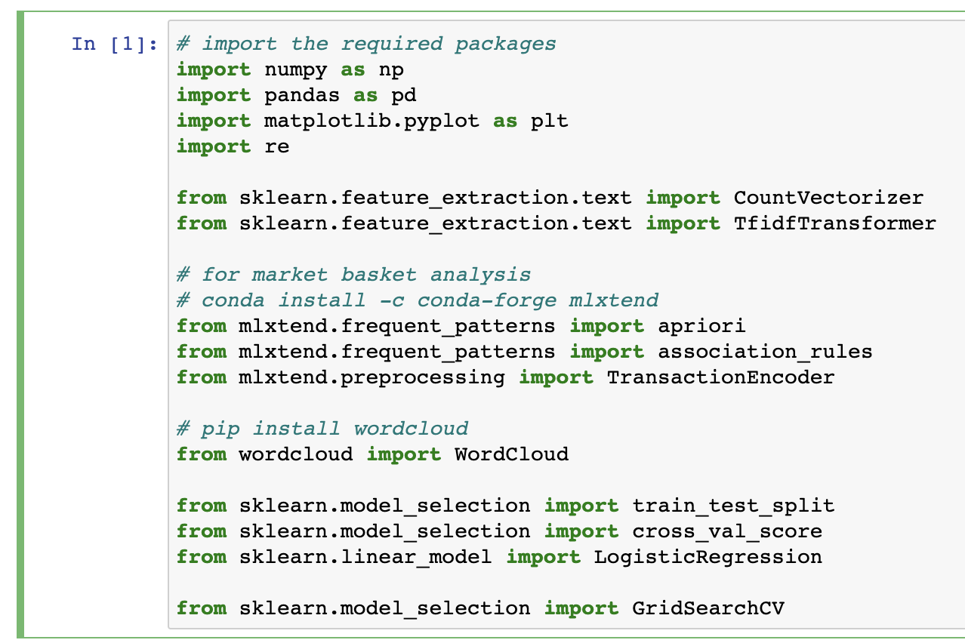
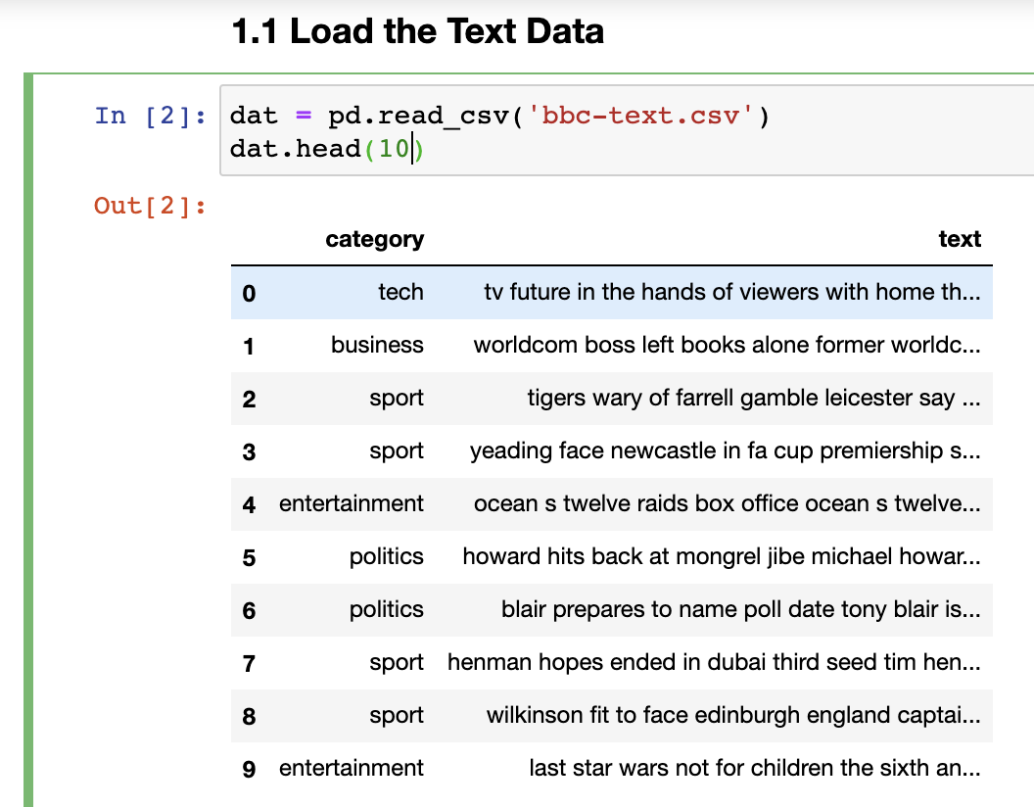
1.1 – Load the text data
Importing necessary libraries ->
Read the file and store the data in a data frame

Slide 6
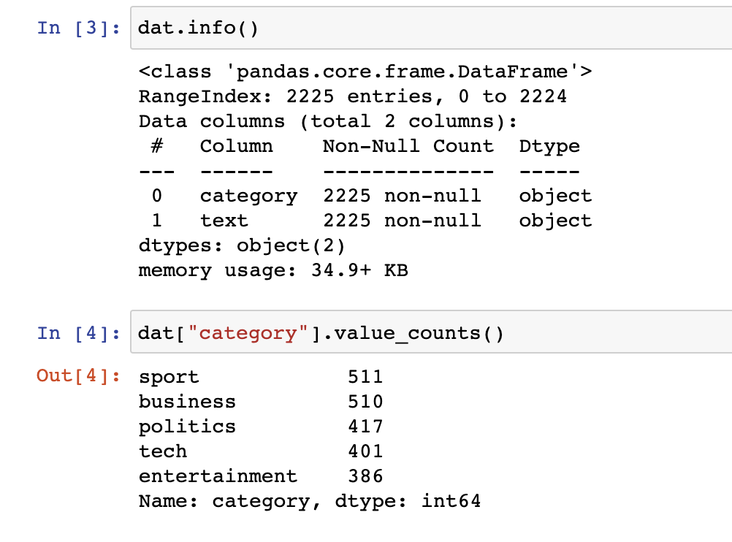
1.1 – Load the text data
Visualizing the data

Slide 7
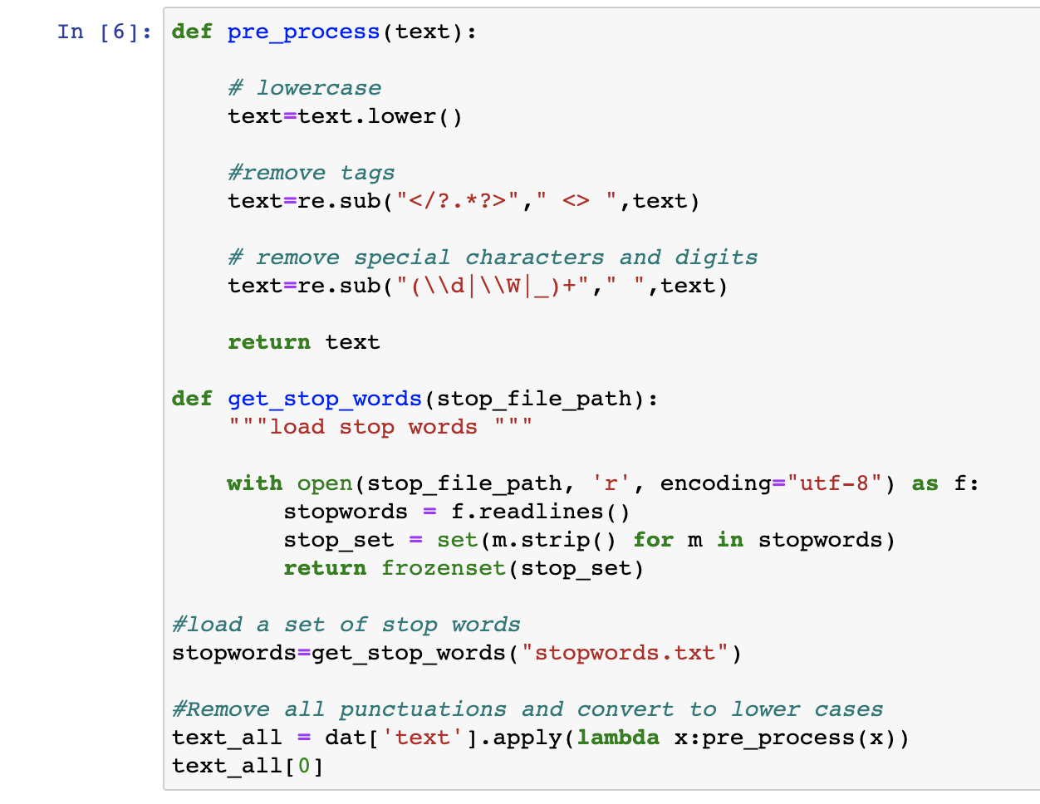
1.2 – Data Cleansing
Covert the text data into lower case and remove all punctuations and special characters

Slide 8
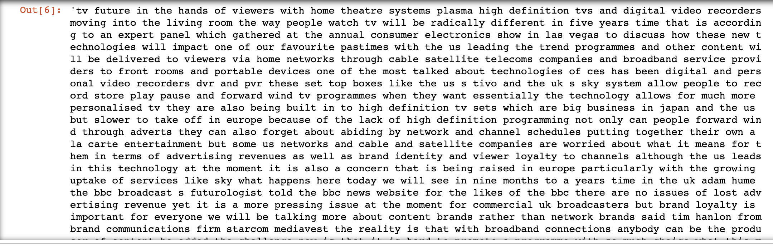
1.2 Data cleansing

Slide 9
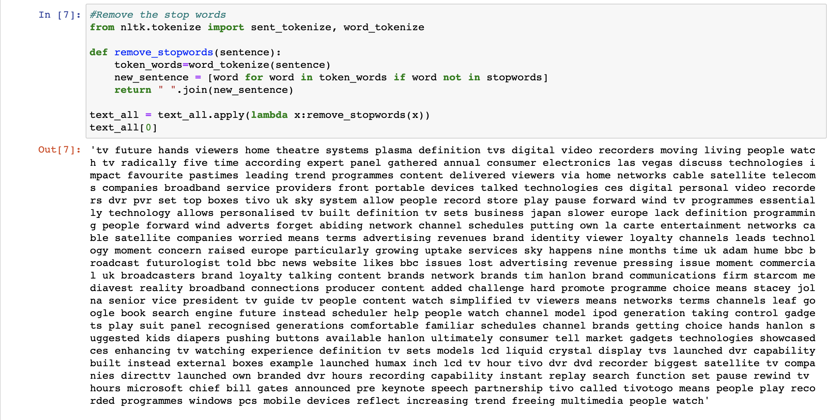
1.2 Cleanse the Text Data
Remove the stop words

Slide 10
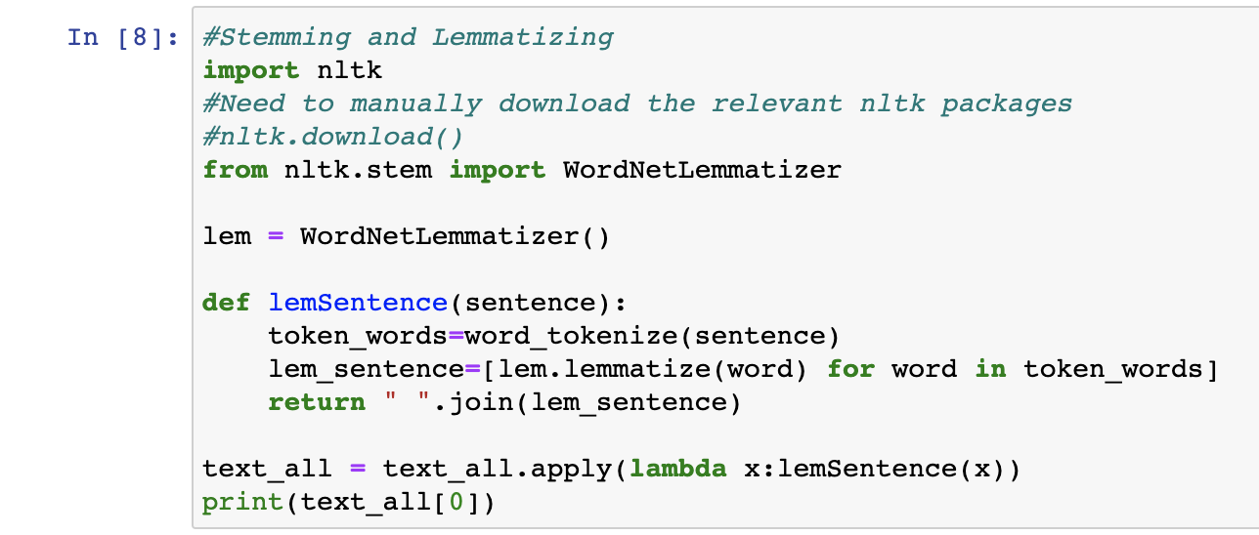
1.2 Data cleansing
Lemmatizing the text data

Slide 11
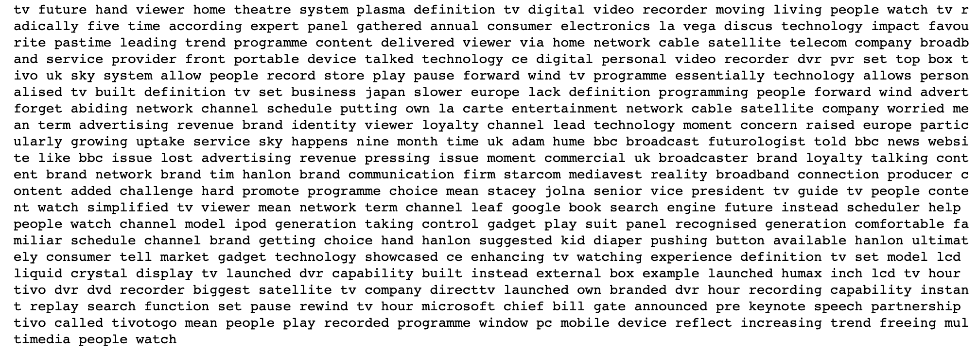
1.2 Data cleansing

Slide 12
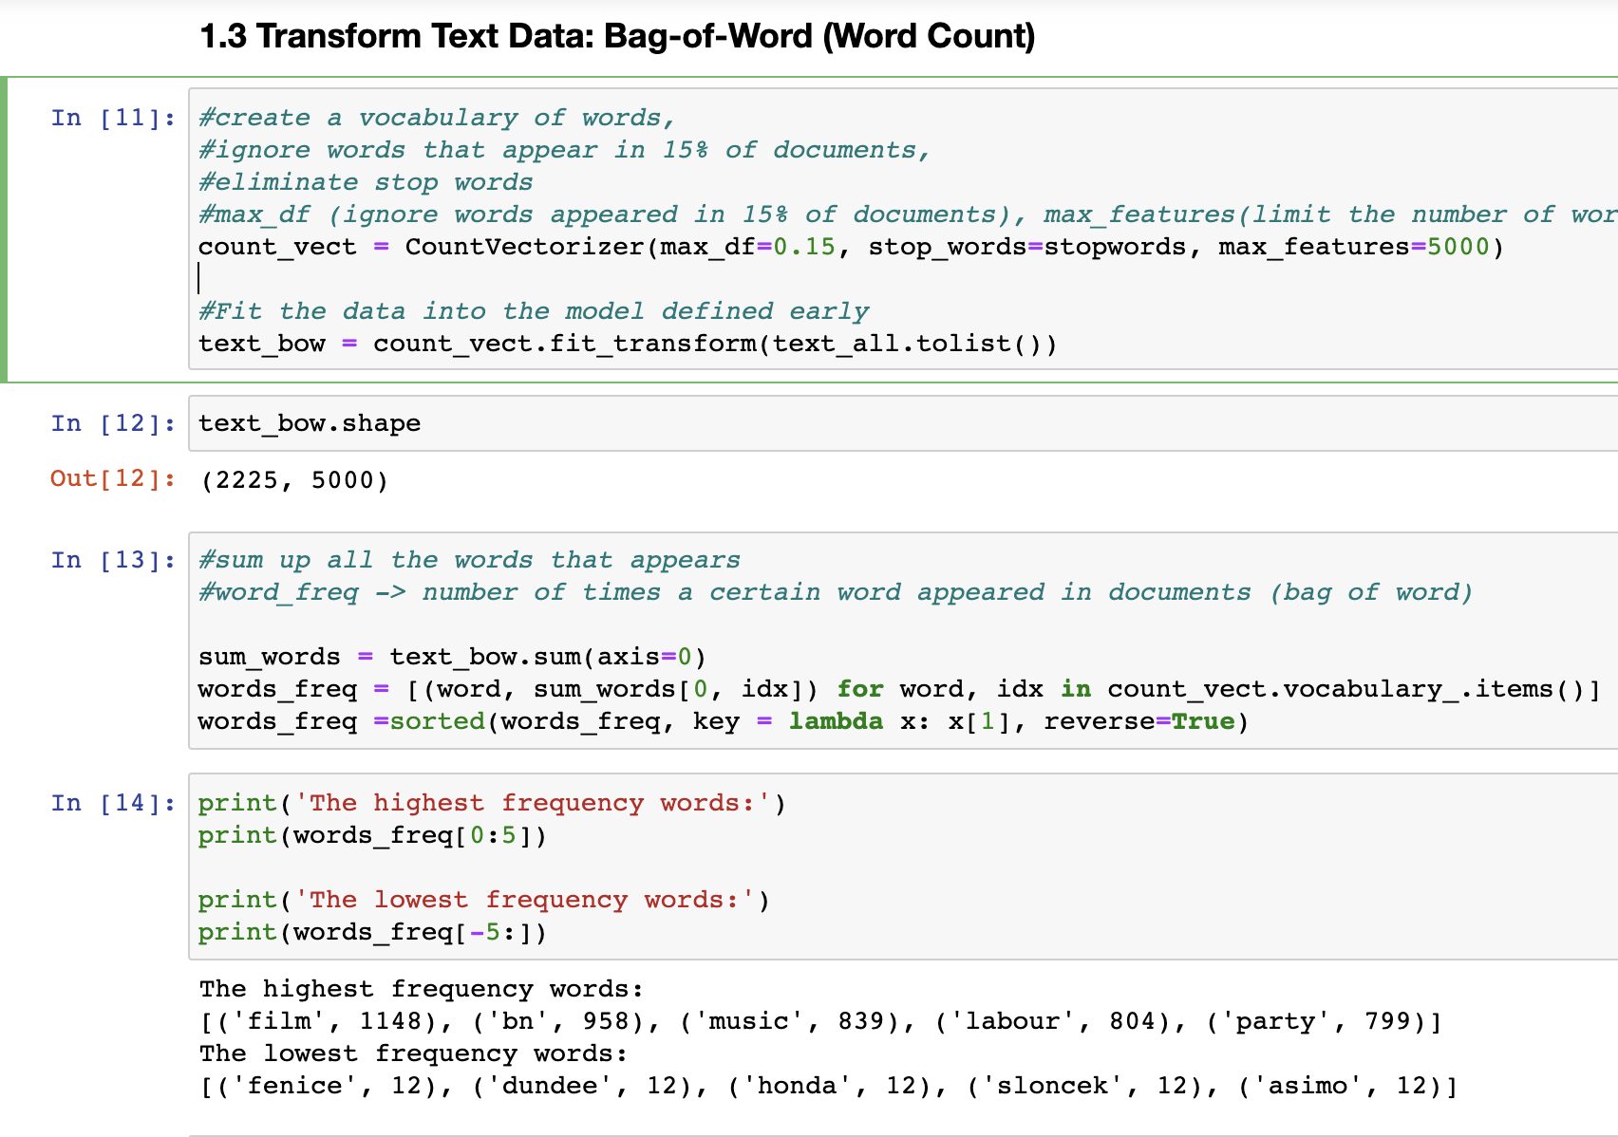
1.3 Transform Text Data – Bag of word
Vectorization
text_bow -> data to use later in modelling

Slide 13
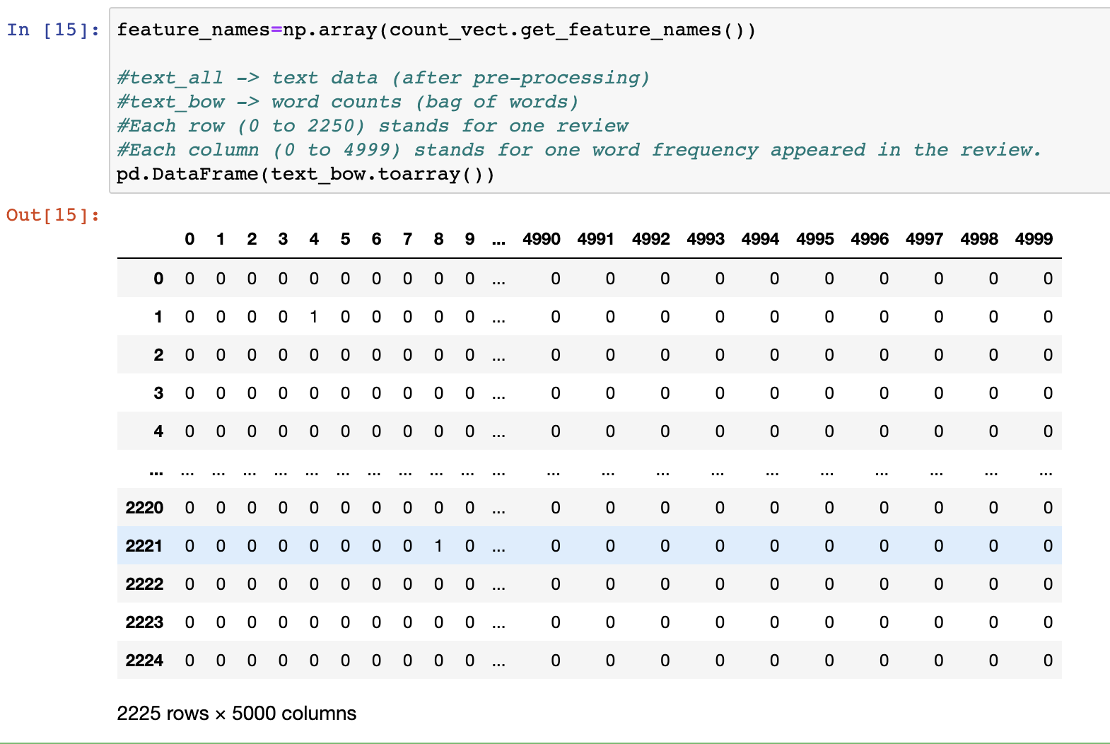
1.3 Transform Text Data – Bag of word
Visualizing text_bow

Slide 14
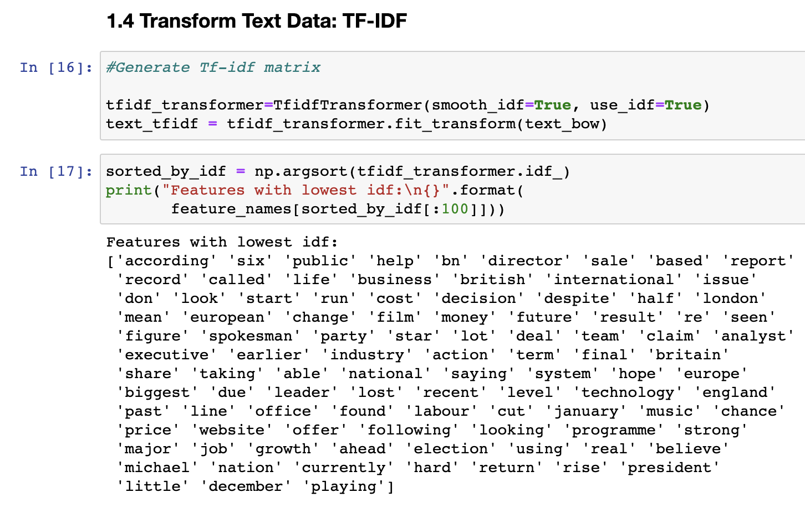
1.4 Transform Text Data – TF-IDF matrix
Transform text_bow into TF-IDF matrix
Visualize features with lowest idf
(Words that occurred most frequently across the entire document)

Slide 15
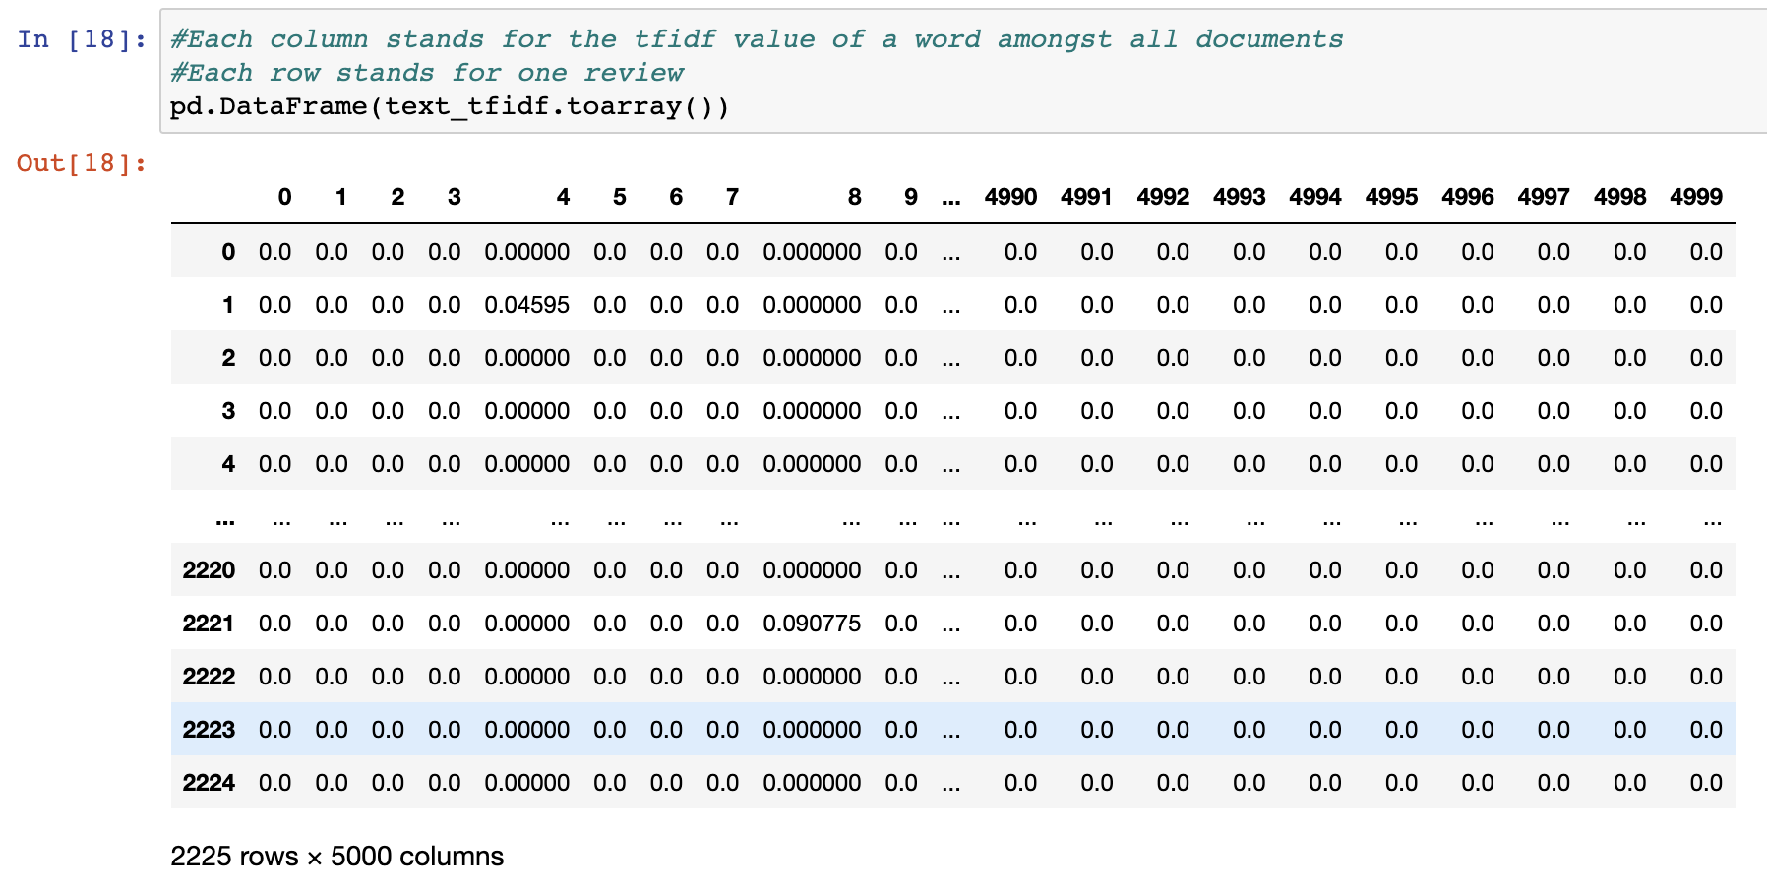
1.4 Transform Text Data – TF-IDF matrix
Visualizing text_tfidf

Slide 16
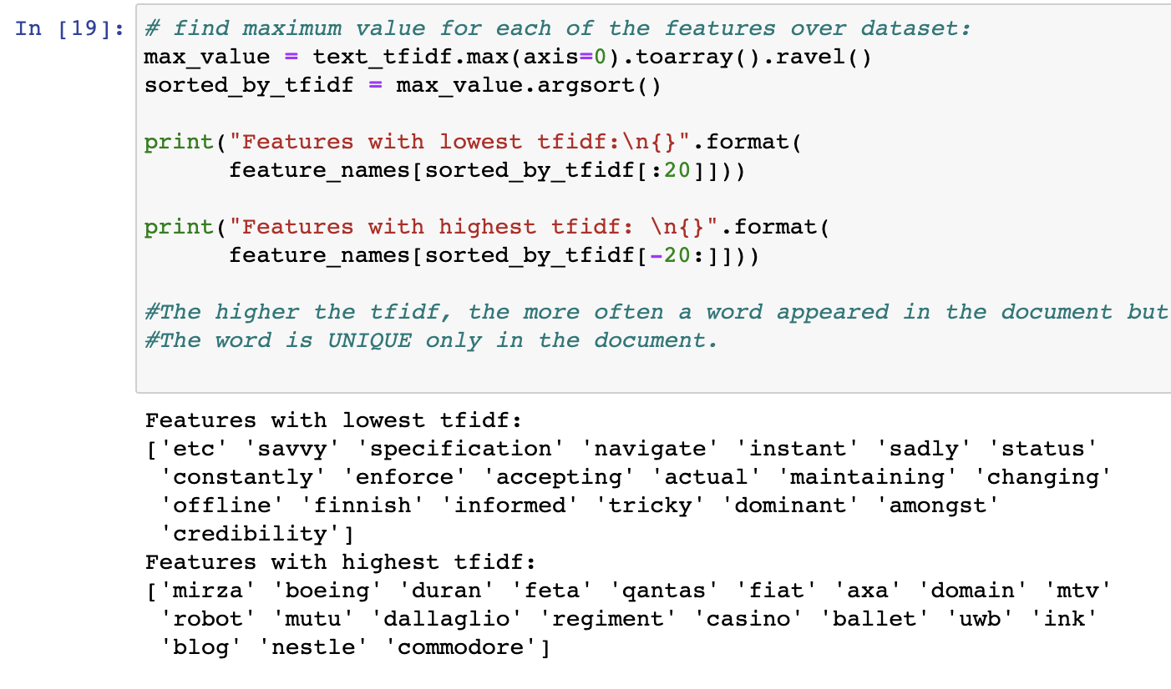
1.4 Transform Text Data – TF-IDF matrix
Visualizing highest and lowest
TF-IDF features

Slide 17
Step 2 – Text Data Understanding

Slide 18
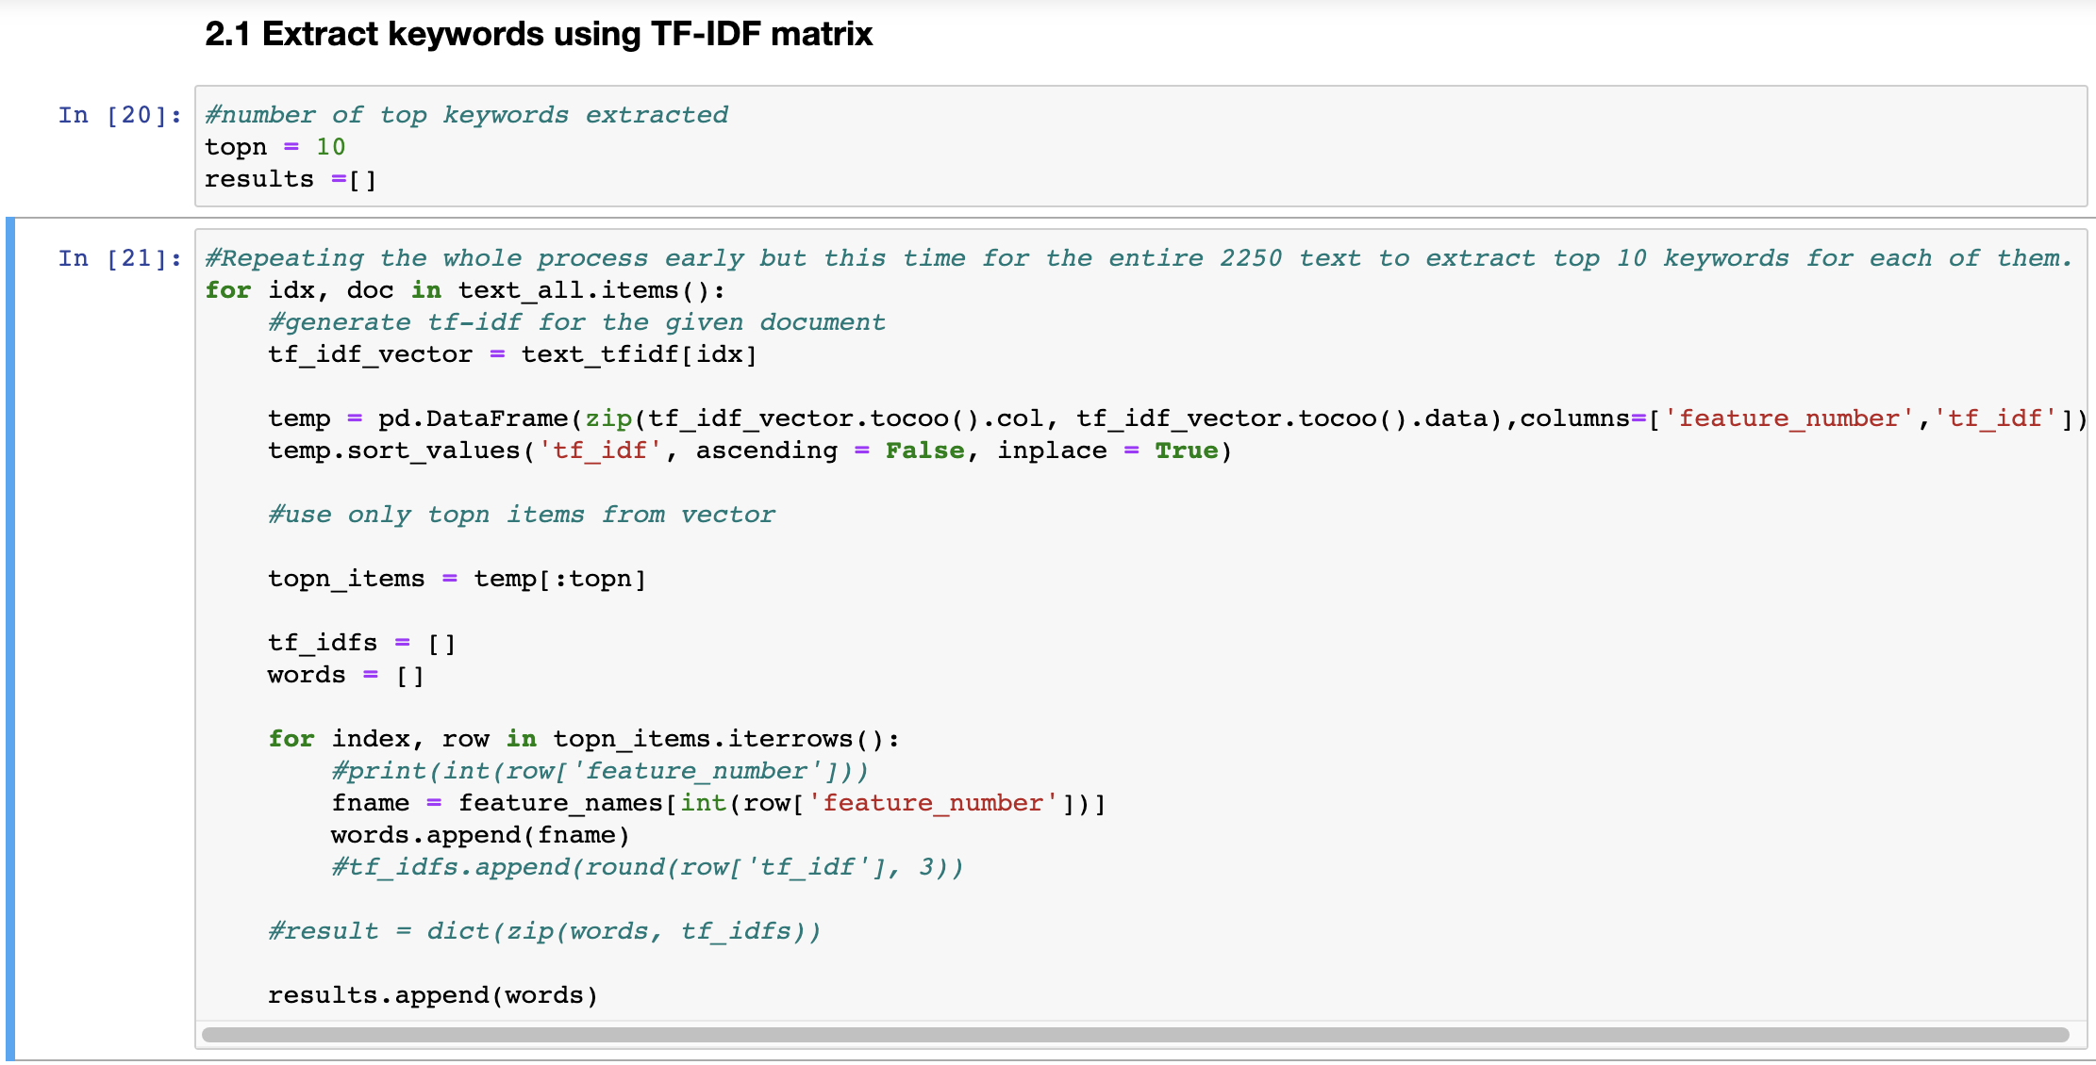
2.1 Extract keywords using TF-IDF matrix
Extract top 10 keywords
with highest TF-IDF scores for
each document

Slide 19
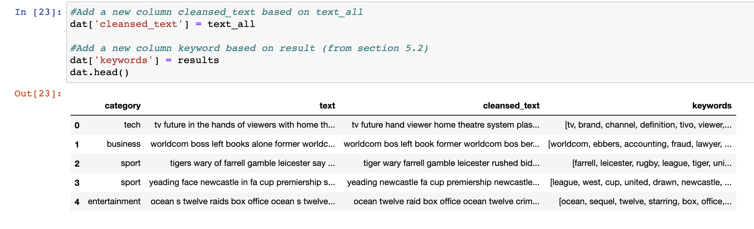
2.1 Extract keywords using TF-IDF matrix
Add cleansed_text and keywords as new columns in the data set

Slide 20
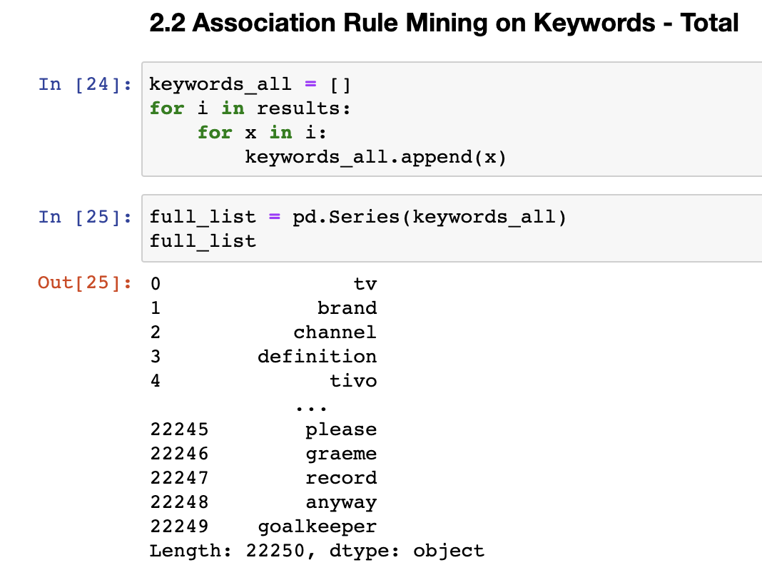
2.2 Association Rule Mining – Overall
Pull out all the keywords and store it in a data frame – full_list
Total keywords -> 2225 x 10 = 22250

Slide 21
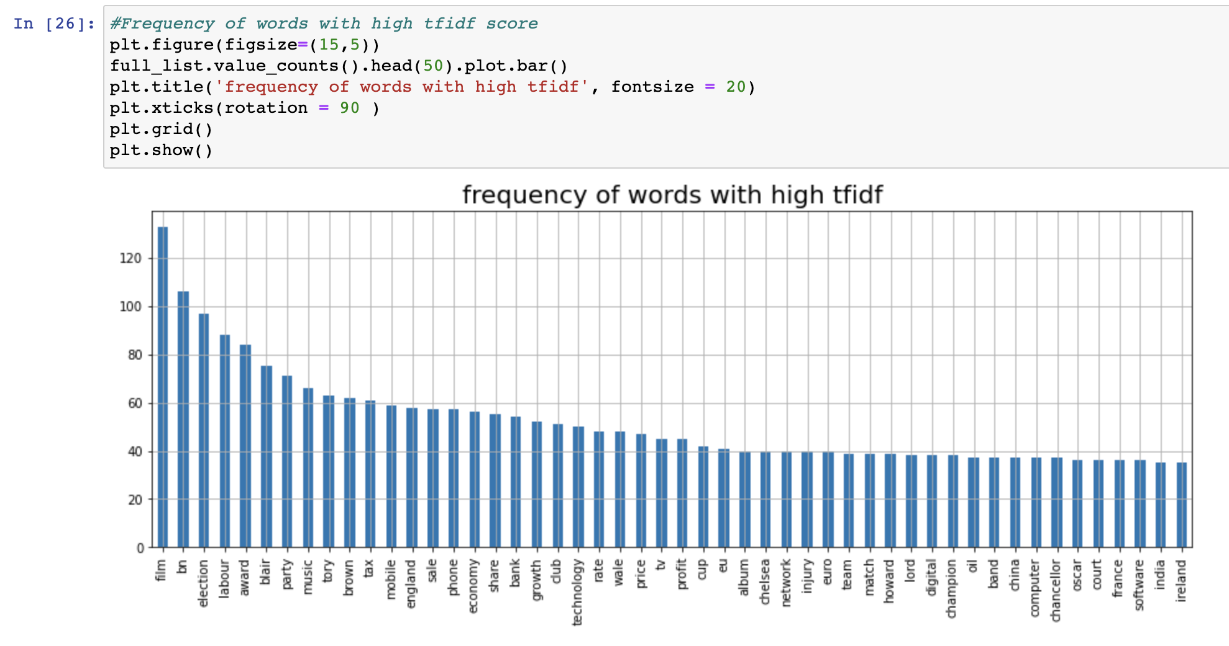
2.2 Association Rule Mining – Overall
Plot a bar chart showing top 50 words with highest tf-idf score

Slide 22
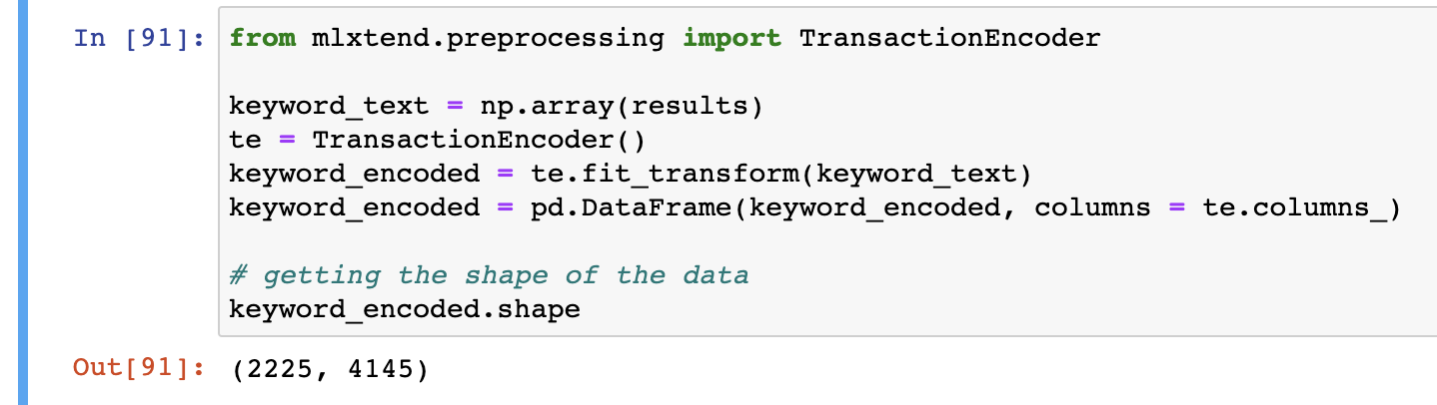
2.2 Association Rule Mining – Overall
Encoded the keywords with 1,0 to use in the Association Rule model later

Slide 23
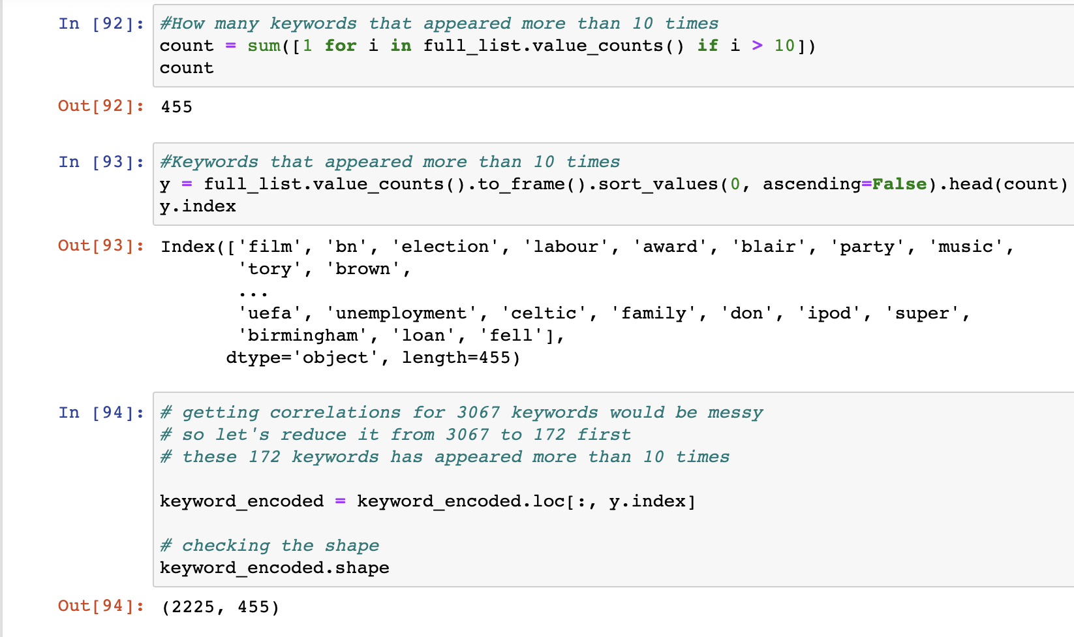
2.2 Association Rule Mining – Overall
Reduce the feature number
Only features appeared at least 10 times are used.

Slide 24
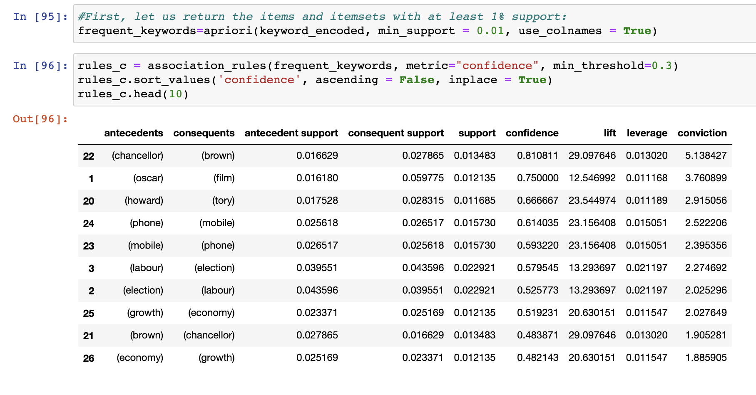
2.2 Association Rule Mining – Overall
Use association rule mining model to determine how strongly two keywords are related.

Slide 25
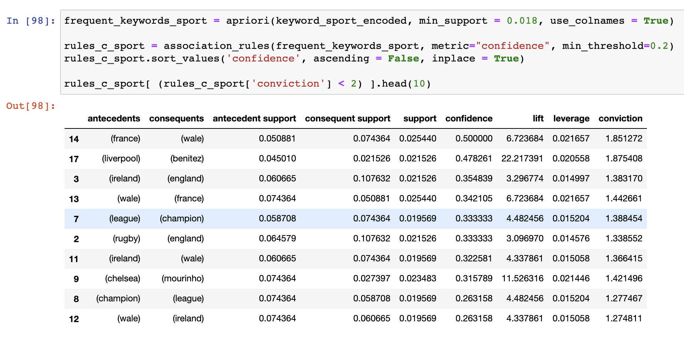
2.3 Association Rule Mining – By category
Sports

Slide 26
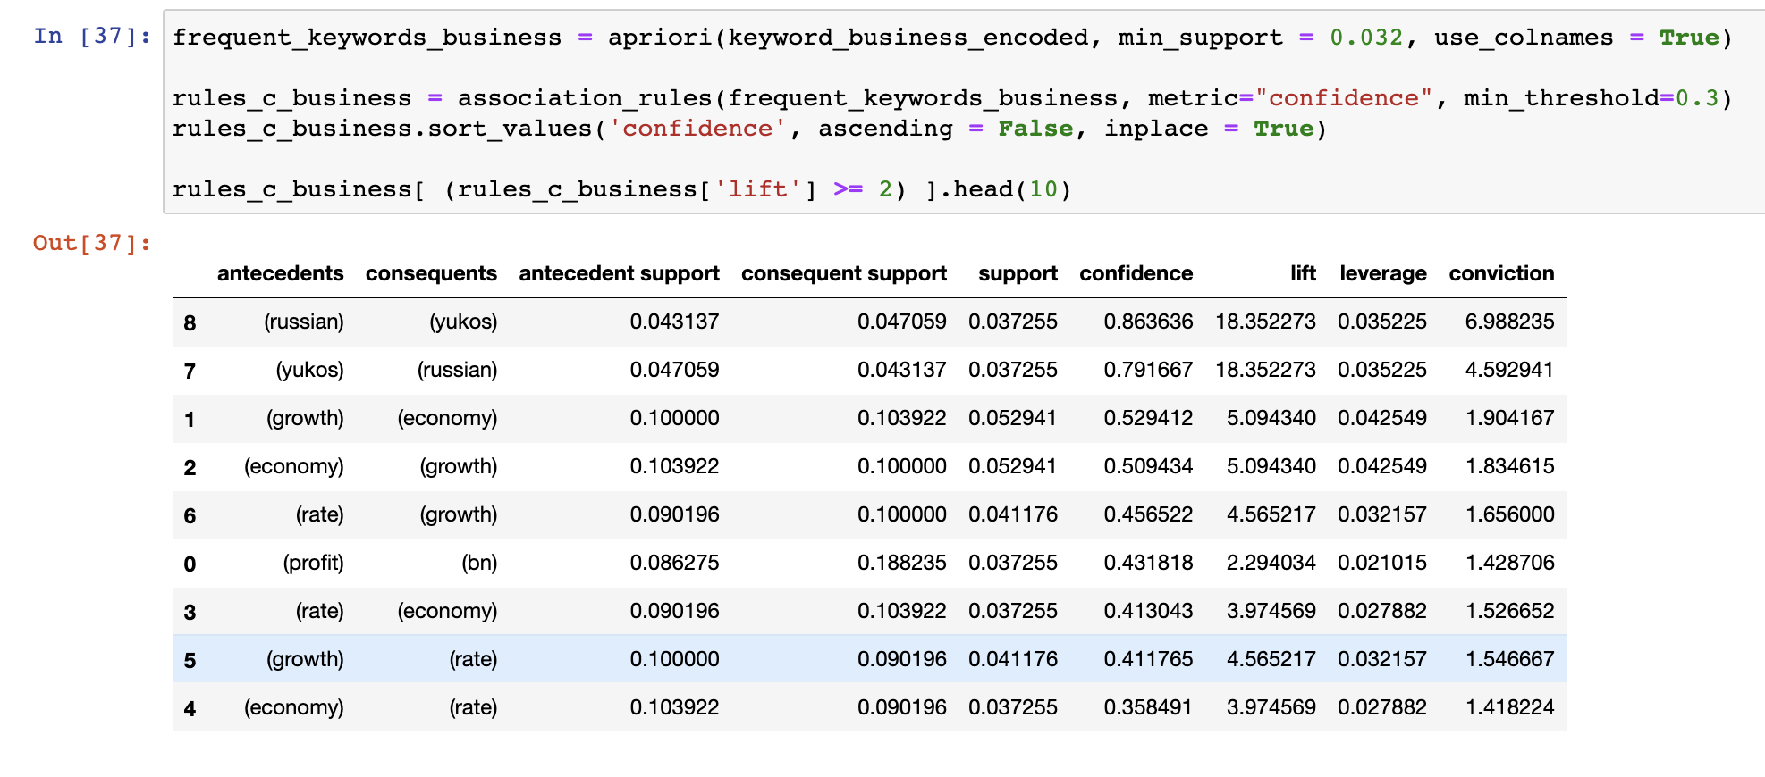
2.3 Association Rule Mining – By category
Business

Slide 27
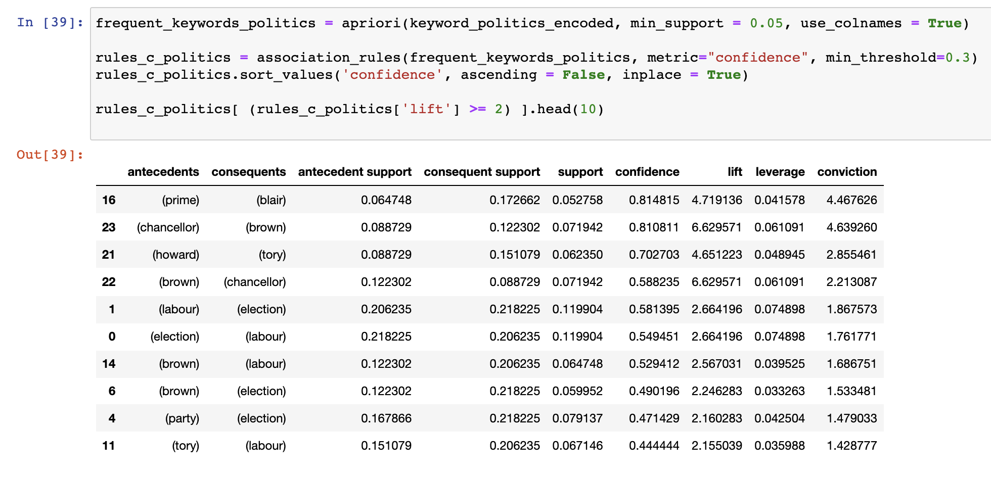
2.3 Association Rule Mining – By category
Politics

Slide 28
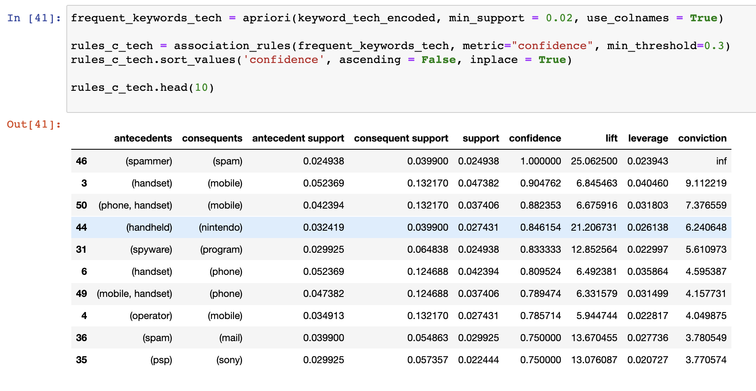
2.3 Association Rule Mining – By category
Tech

Slide 29
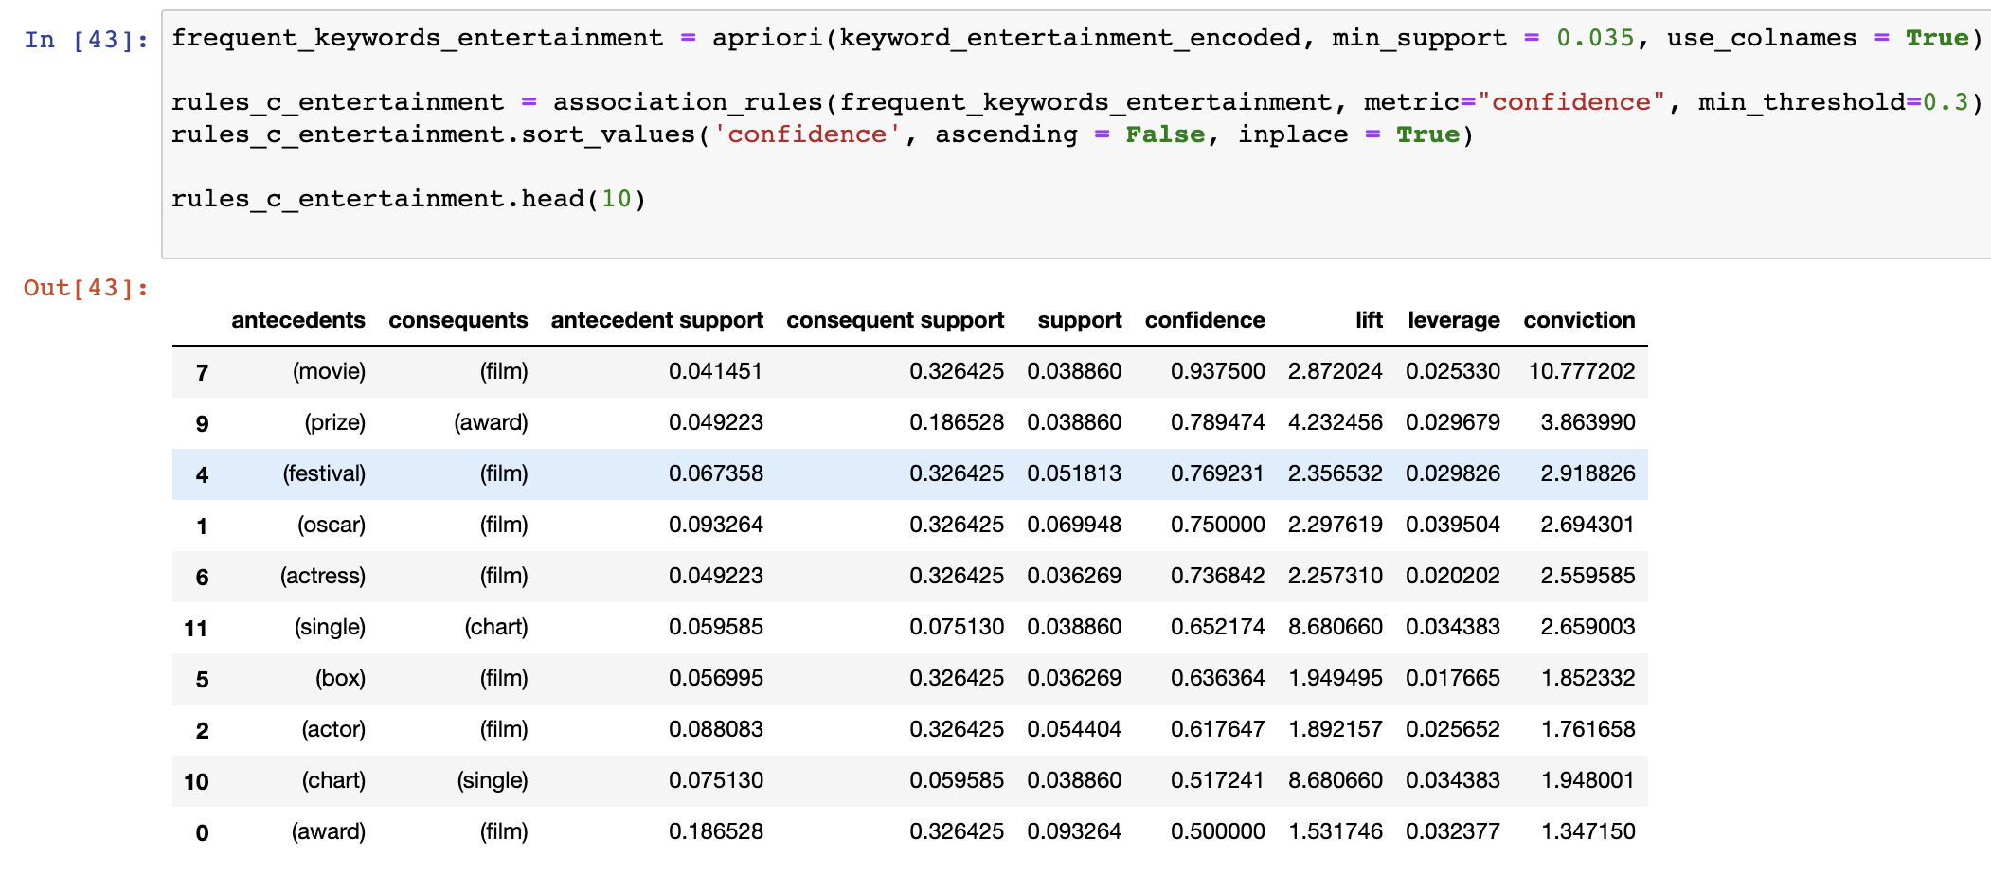
2.3 Association Rule Mining – By category
Entertainment

Slide 30
Step 3 – Classification Modelling

Slide 31
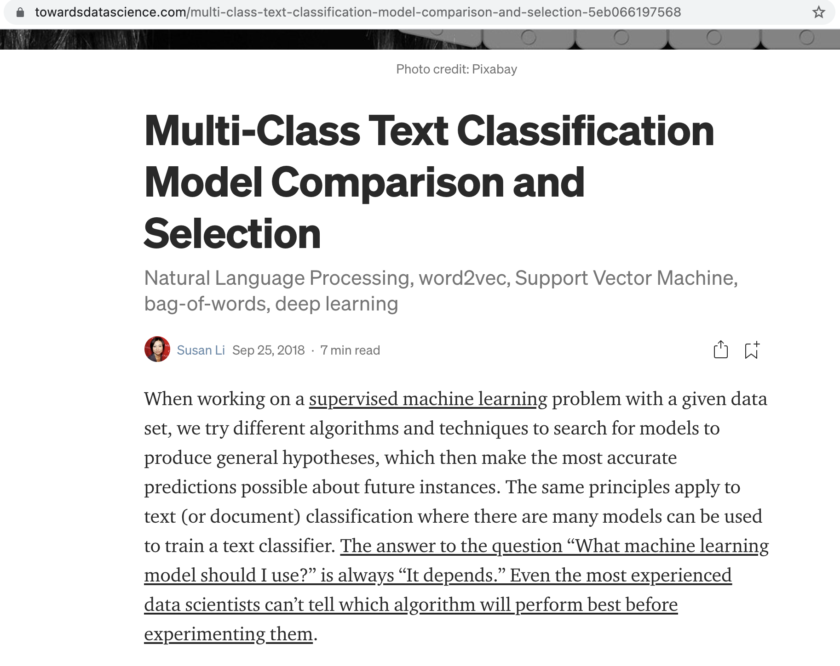
Research
https://towardsdatascience.com/multi-class-text-classification-model-comparison-and-selection-5eb066197568

Slide 32
Research
Classification Models Used
Logistic Regression
Linear Support Vector Machine(SVM) - SGD Classifier
Random Forest Classifier

Slide 33
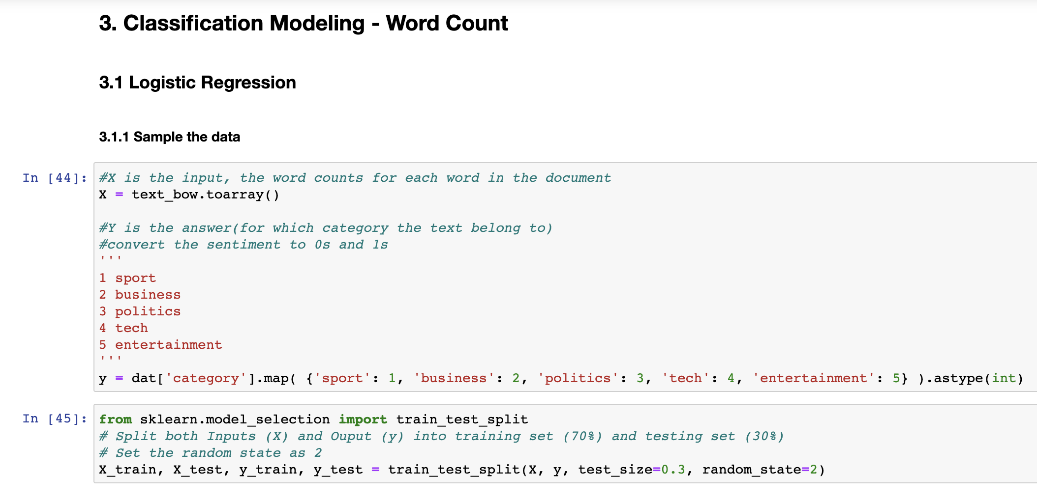
Logistic Regression – Word Count

Slide 34
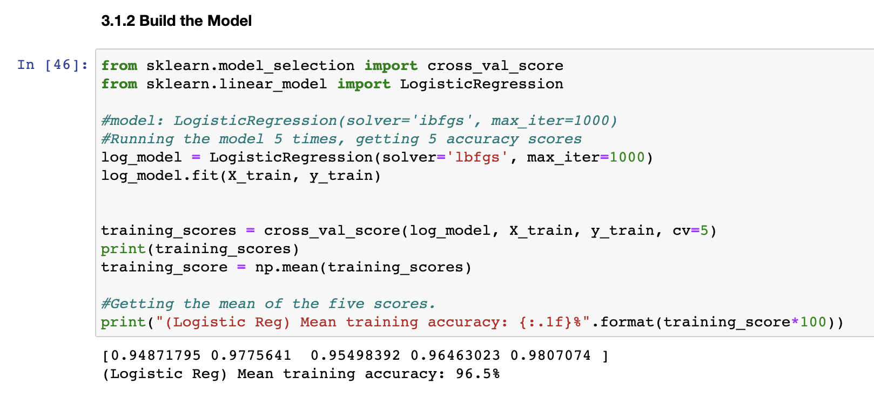
Logistic Regression – Word Count

Slide 35
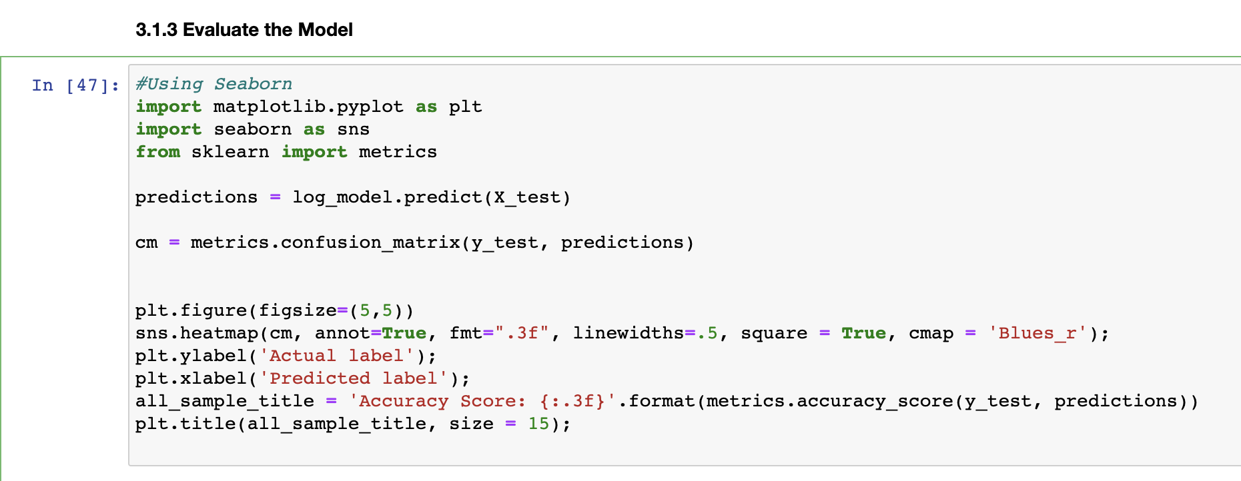
Logistic Regression – Word Count

Slide 36
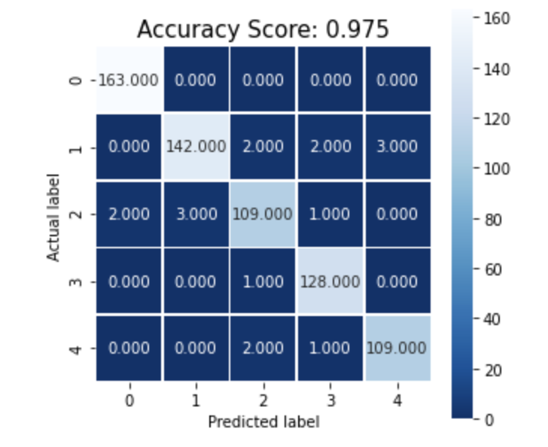
Logistic Regression – Word Count
Boxes with light background indicates correct prediction
Boxes with dark background indicates incorrect prediction
E.g. in col 2, row 1 -> value is 2
Means that 2 labels are predicted as politics where it is actually business

Slide 37
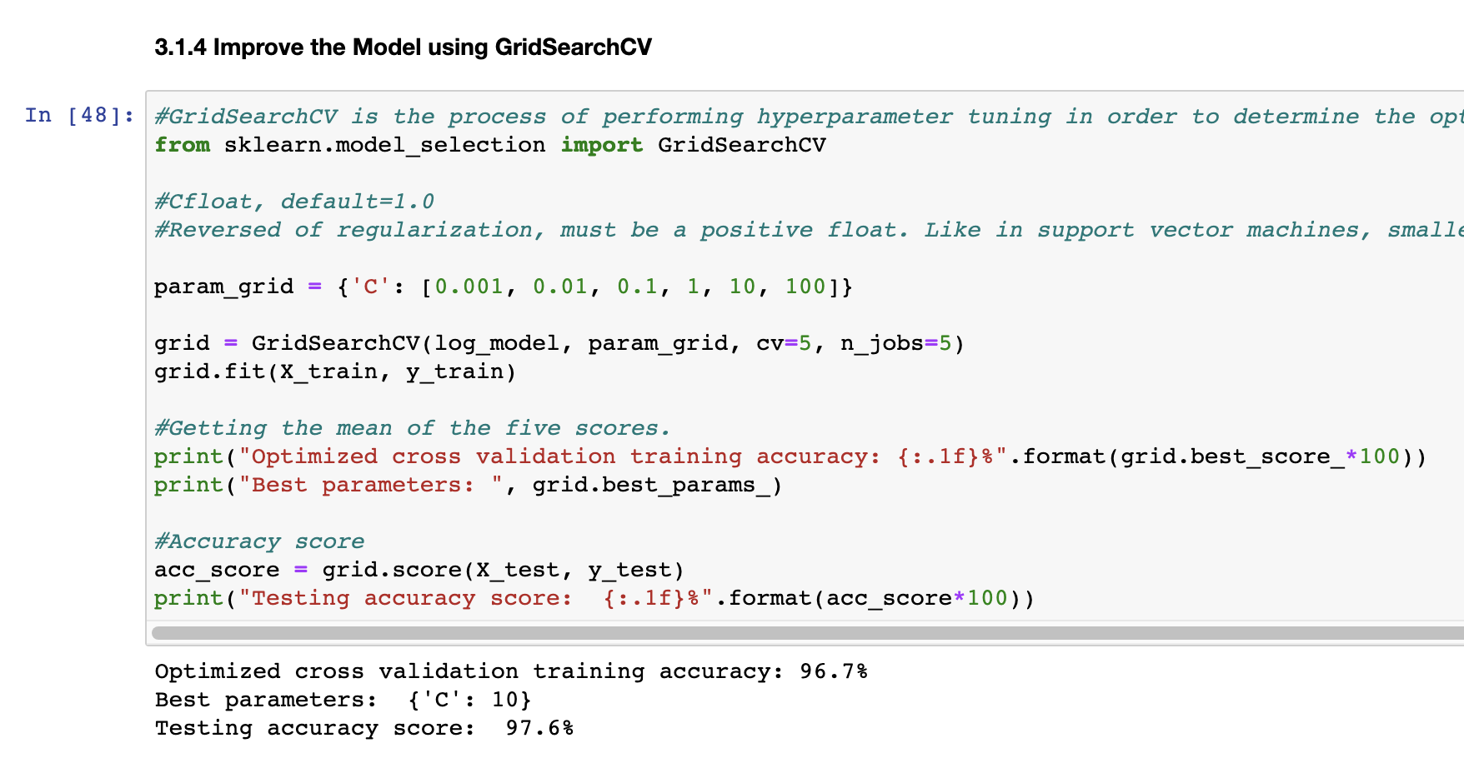
Logistic Regression – Word Count
Using GridSearchCV for hyperparameter tuning

Slide 38
SGD Classifier
Stochastic Gradient Descent (SGD) is a simple yet very efficient approach to fitting linear classifiers and regressors under convex loss functions such as
Linear Support Vector Machines (loss = “hinge”) ←
Logistic Regression (loss = “log”)

Slide 39
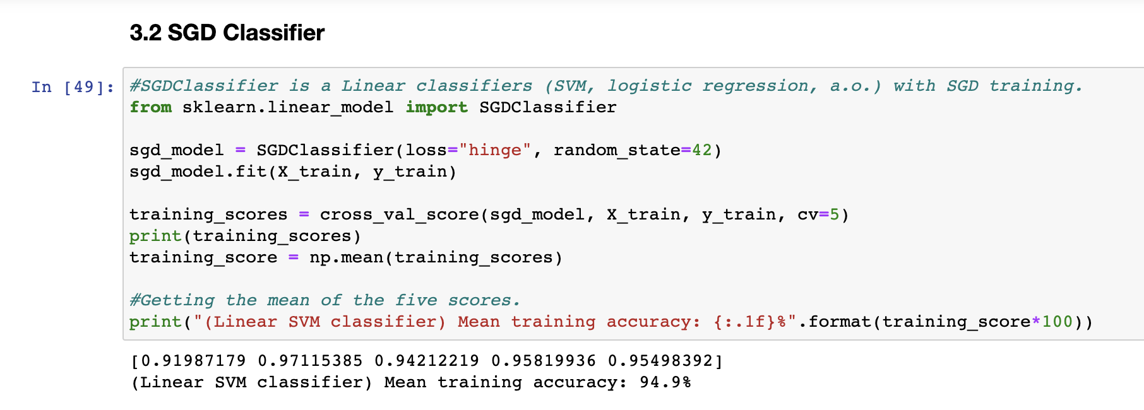
SGD Classifier – Word Count

Slide 40
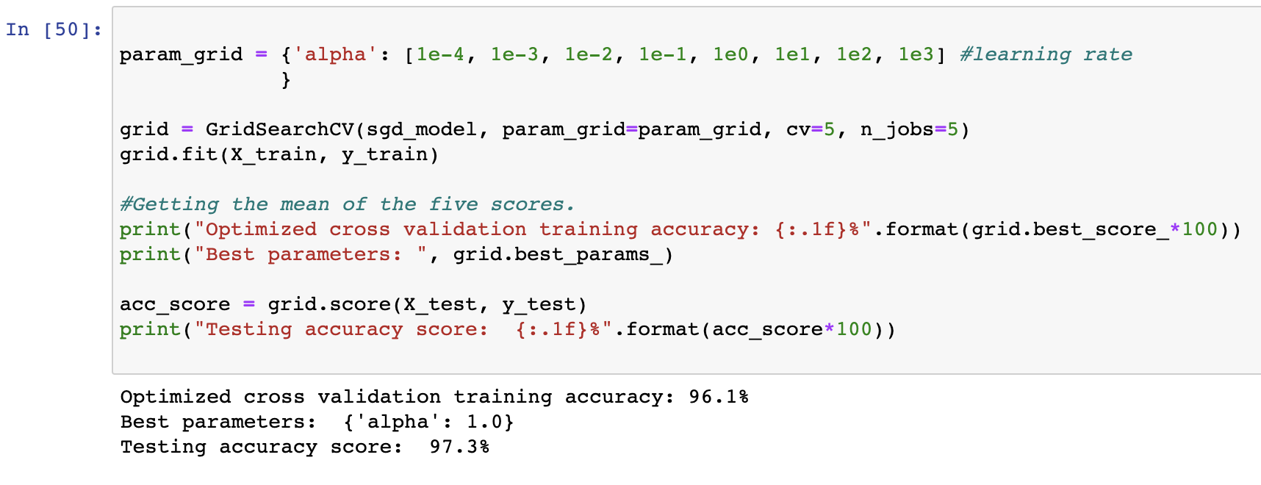
SGD Classifier – Word Count

Slide 41
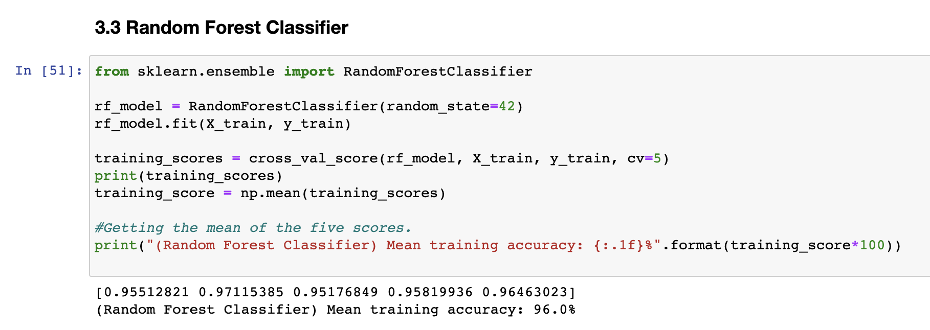
Random Forest Classifier – Word Count

Slide 42
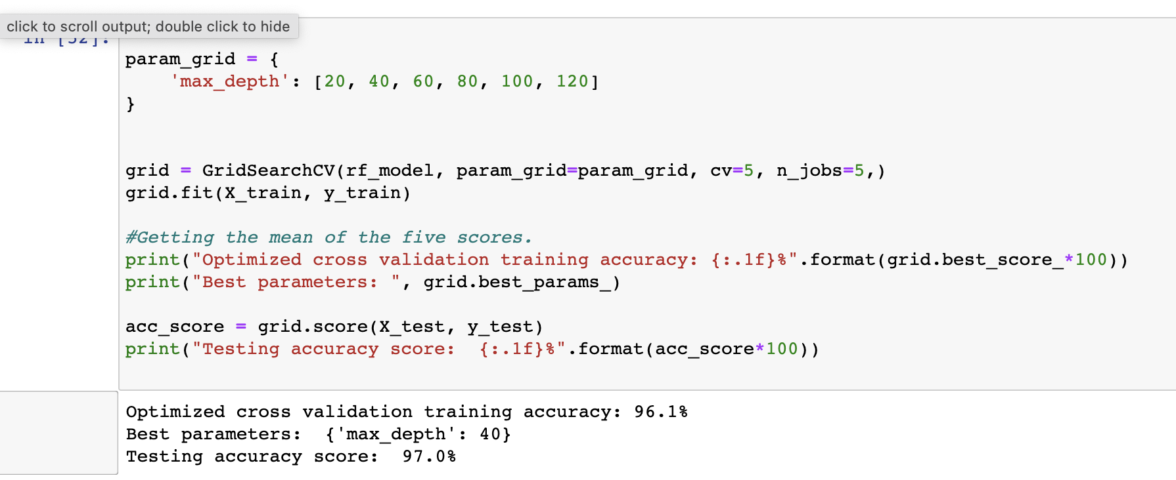
Random Forest Classifier – Word Count

Slide 43
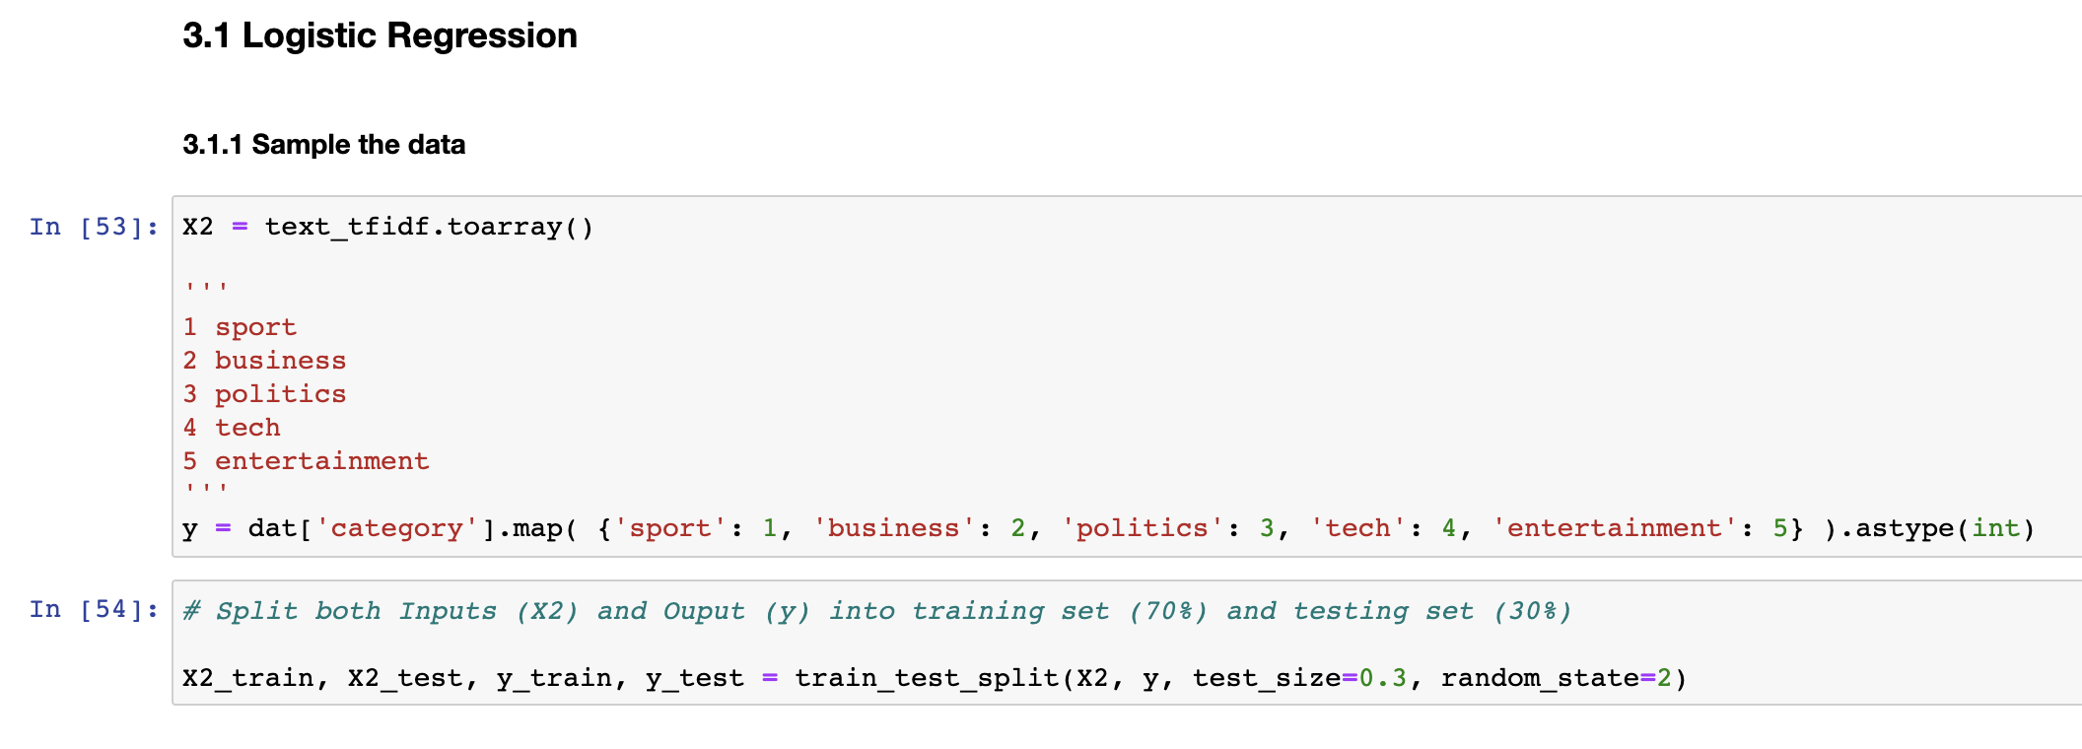
Logistic Regression – TF-IDF

Slide 44
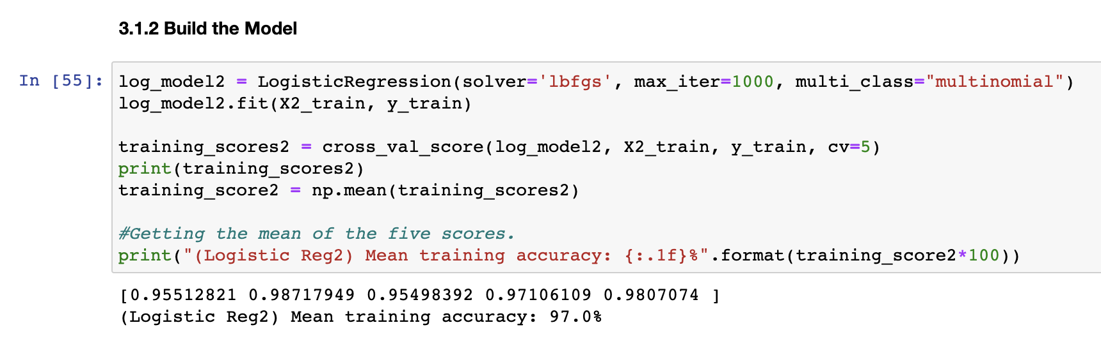
Logistic Regression – TF-IDF

Slide 45
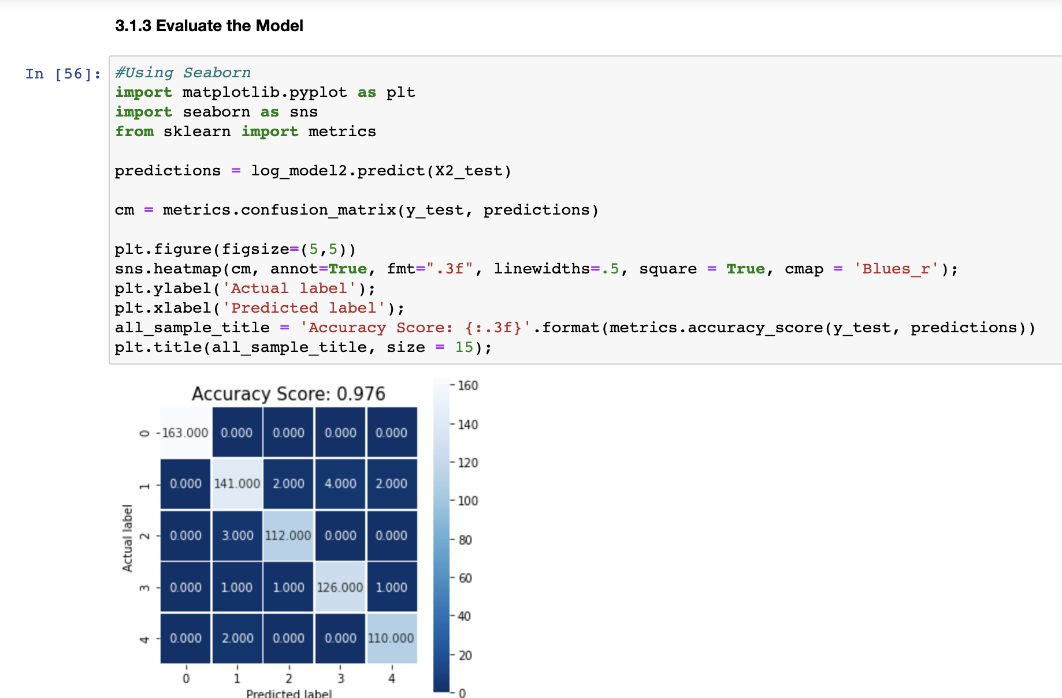
Logistic Regression – TF-IDF

Slide 46
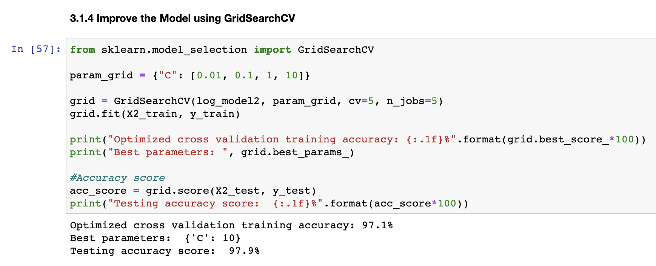
Logistic Regression – TF-IDF

Slide 47
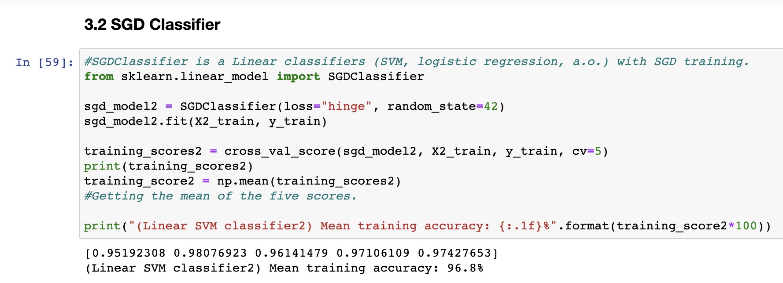
SGD Classifier – TF-IDF

Slide 48
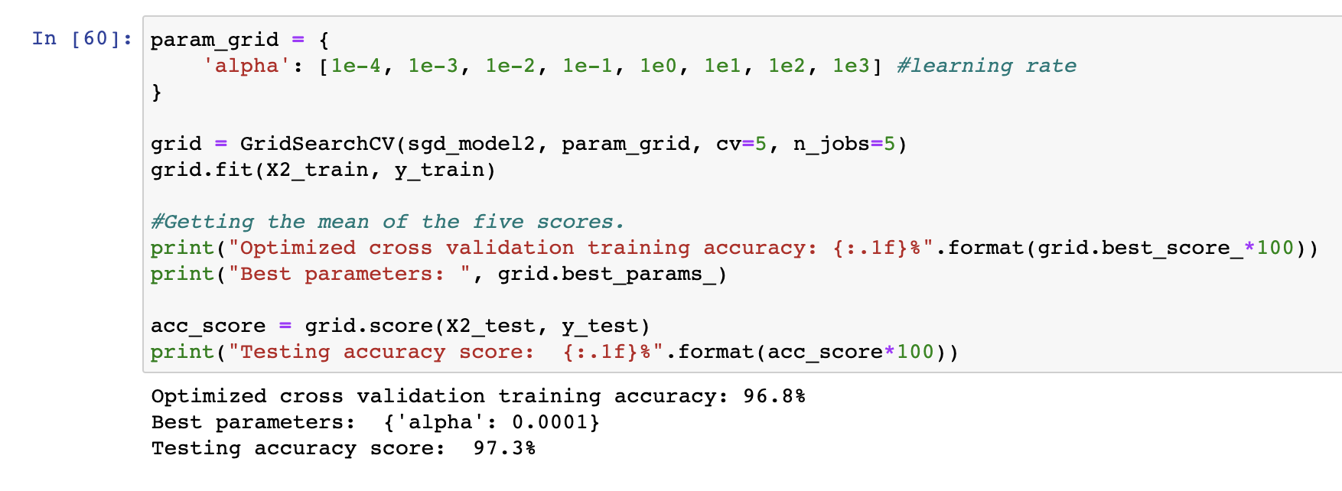
SGD Classifier – TF-IDF

Slide 49
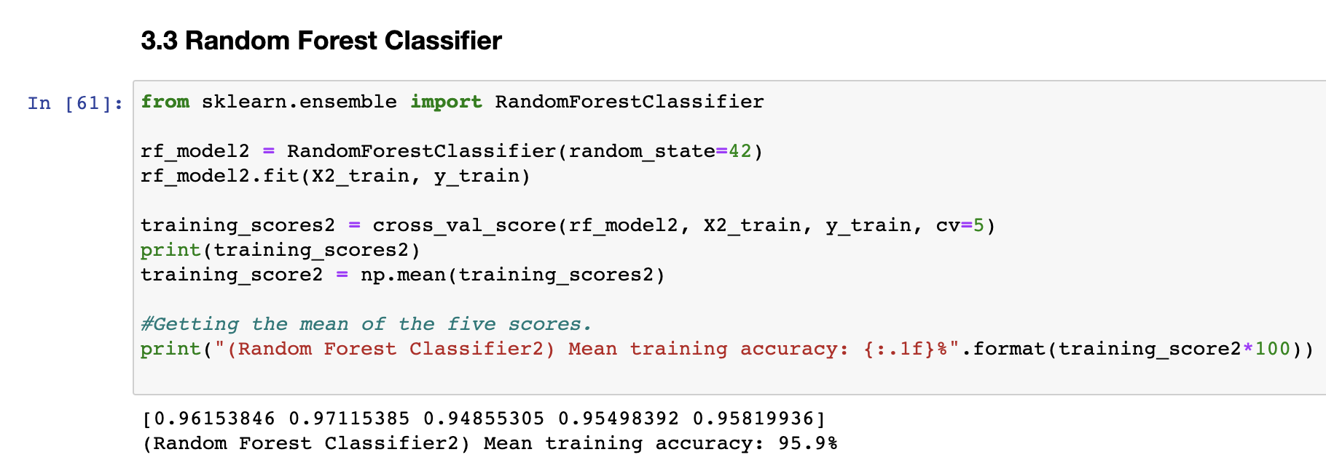
Random Forest Classifier – TF-IDF

Slide 50
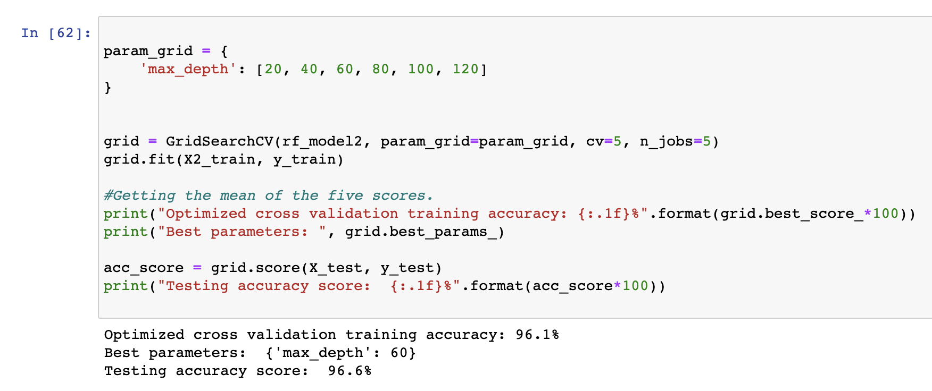
Random Forest Classifier – TF-IDF

Slide 51
Step 4 – Summarize the findings

Slide 52
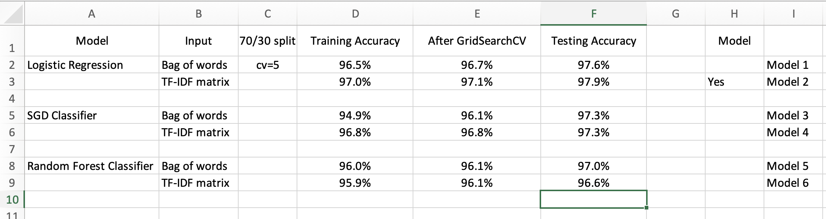
Model Evaluation

Slide 53
Further Improvements
Trying out more Classification models to compare the accuracy and speed.
Such as Naïve Bayes Algorithm
More findings on different hyperparameters used in each classification model.

Slide 54
Thank You

